Slide 1
Automating your Desktop with PowerShell Universal
Adam Driscoll

Slide 2
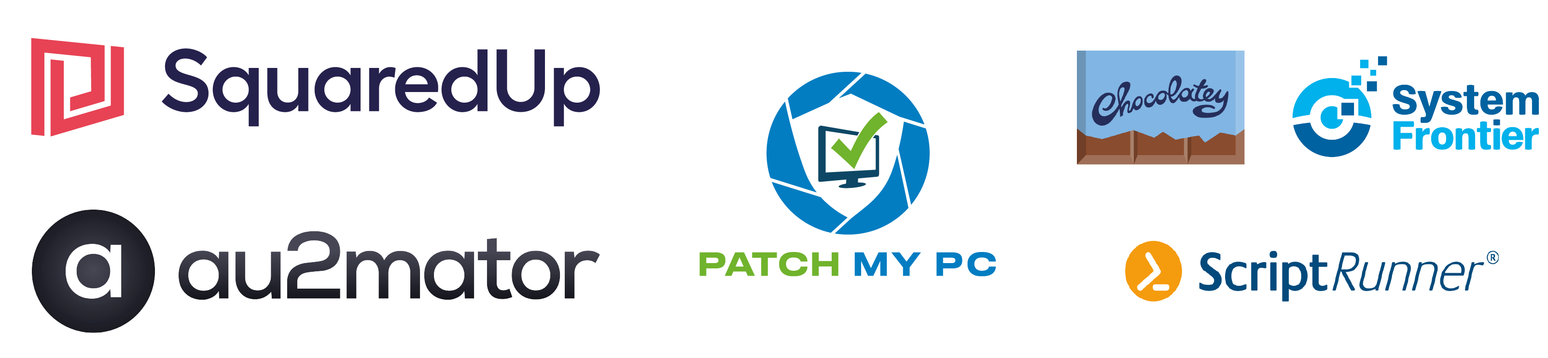
Many thanks to our sponsors:

Slide 3
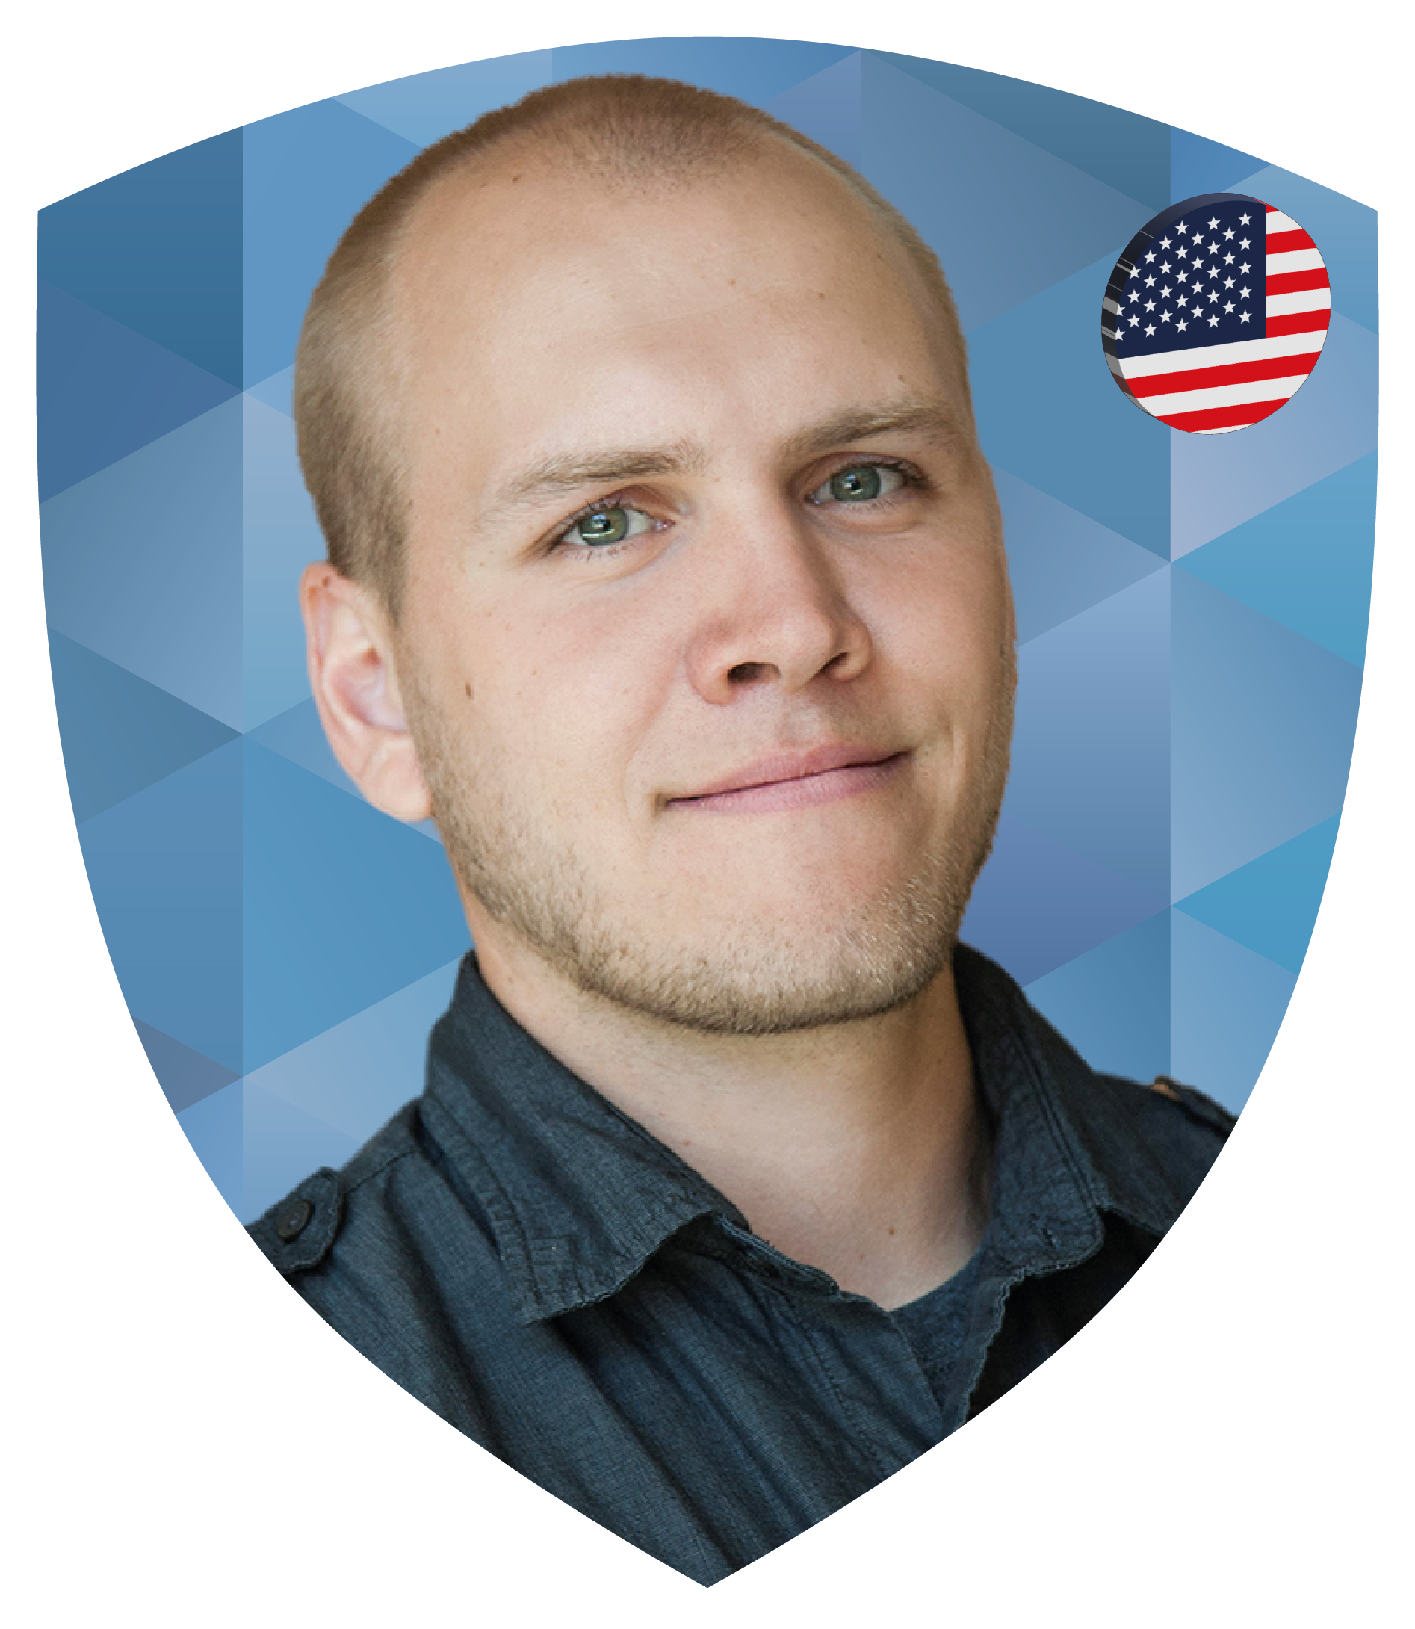
Adam Driscoll
Microsoft MVP 10x
Founder of Ironman Software
PowerShell Tools for Visual Studio
PowerShell Pro Tools
PowerShell Universal
Author, YouTuber, Blogger
Cyclist, Outdoor Enthusiast

Slide 4
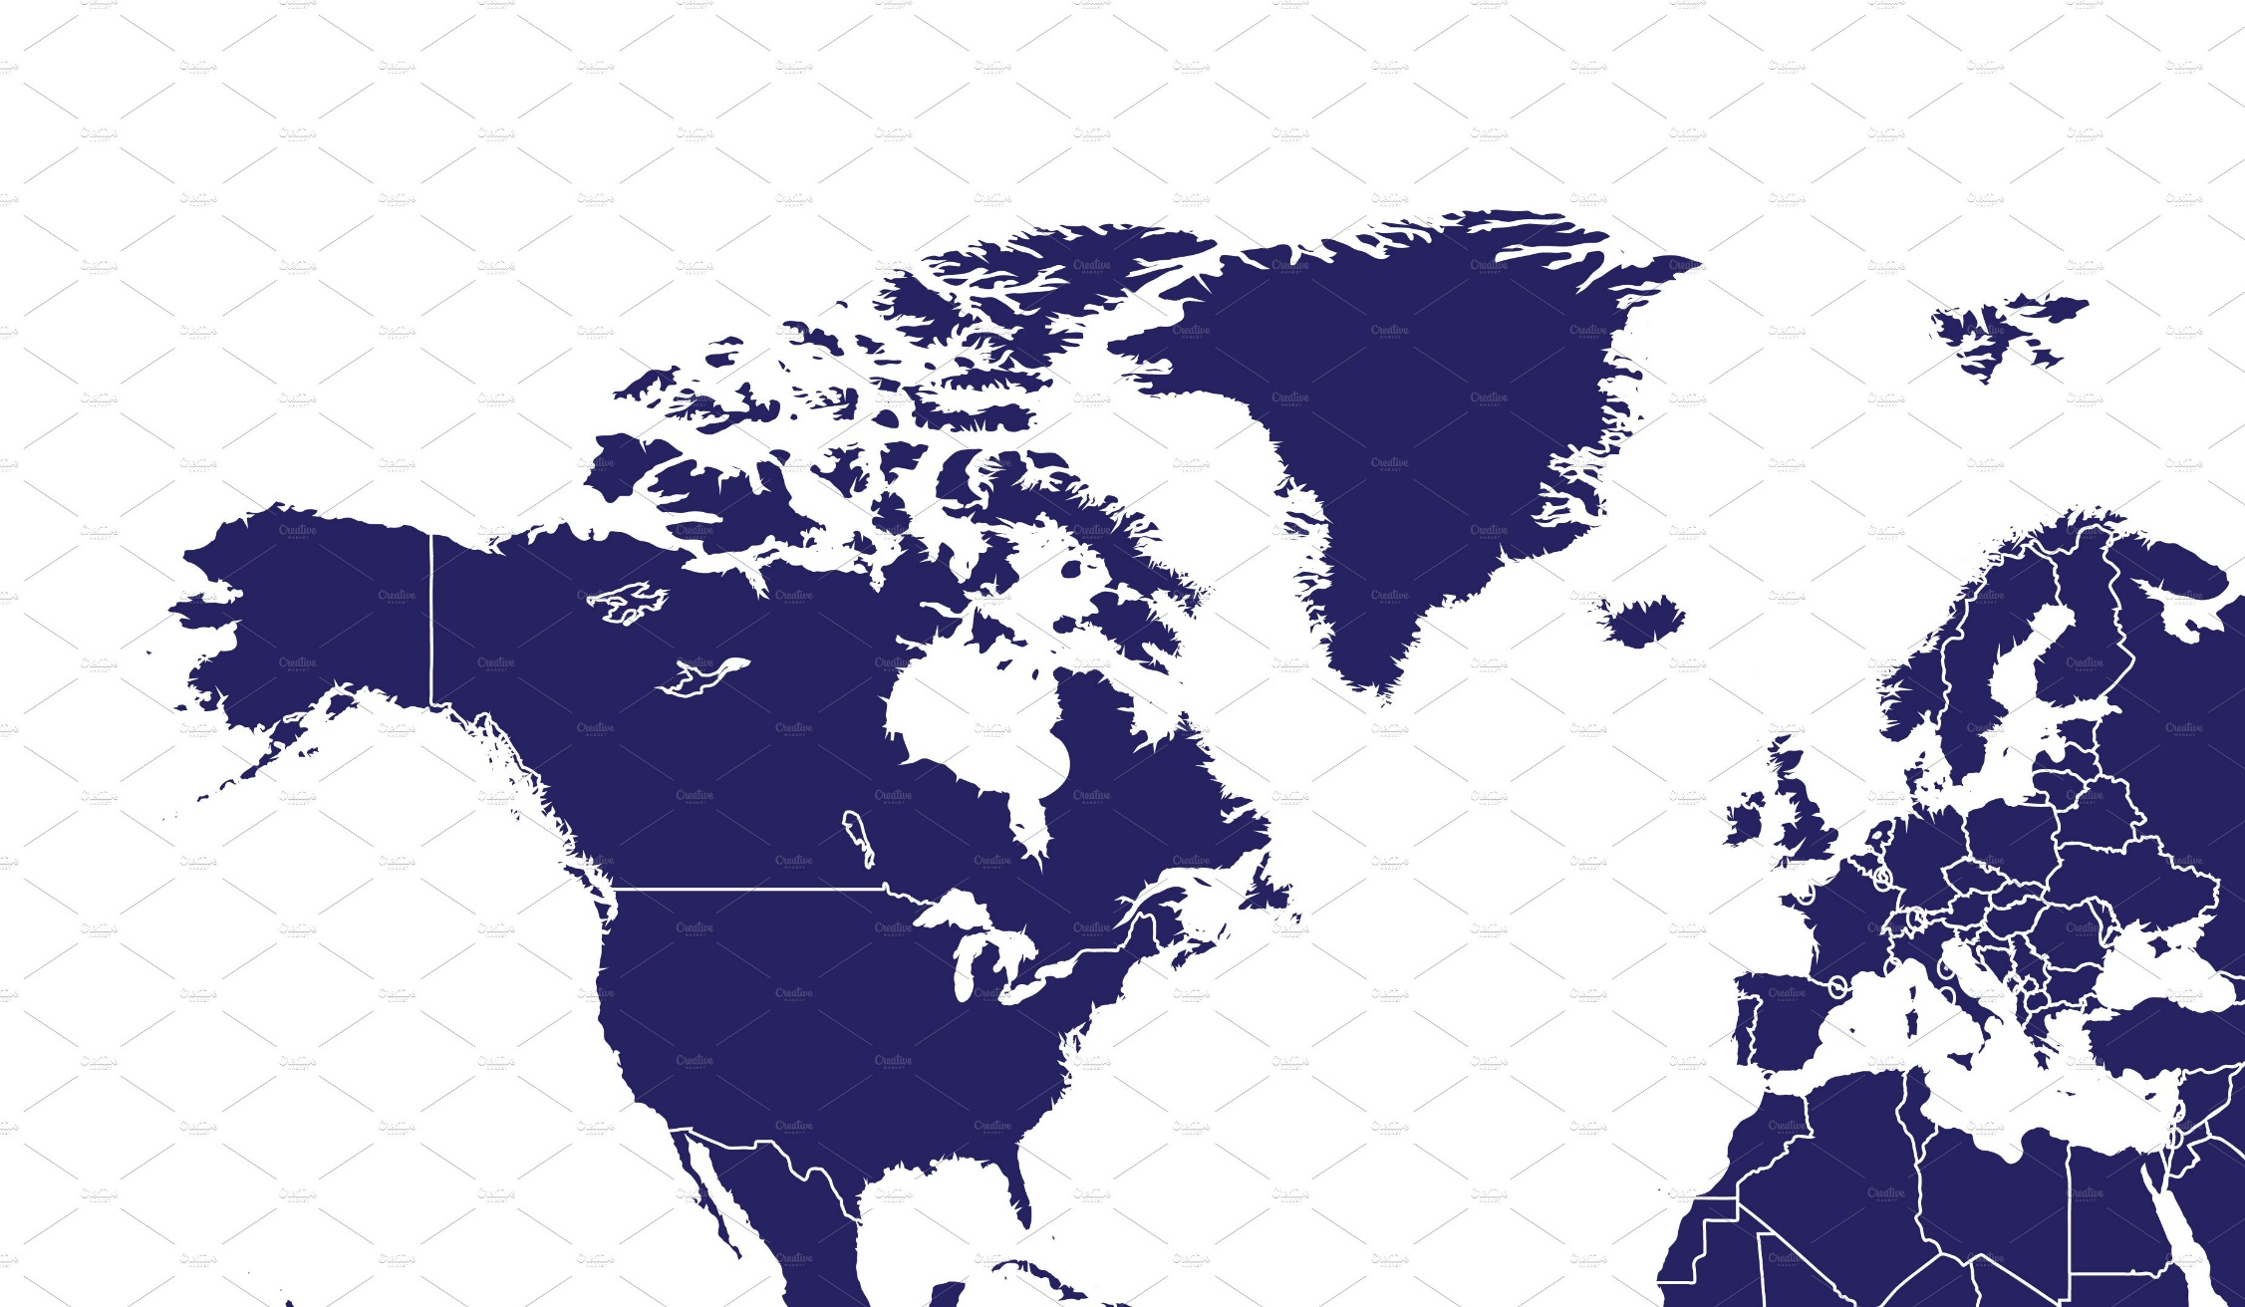
How’d I Get Here?
Hailey, ID, USA
6 hours canceled flight
2.5 hour bus ride
Boise, ID, USA
Overnight stay
2.5 hour flight
Los Angeles, CA, USA
8 hour layover
Missed flight
9 hour flight
London, UK
8 hour layover
2 hour flight
Vienna, AU
Total Travel Time: 53 hours

Slide 5








PowerShell Universal
What is PowerShell Universal?
APIS
AUTOMATION
USER INTERFACES
ENVIRONMENTS
Create RESTful APIs that execute PowerShell scripts from anywhere.
Run and schedule scripts, listen to events and run in-browser terminals. with tight integration with the PowerShell host.
Build highly interactive user interfaces with PowerShell scripts.
Take advantage of multiple PowerShell environments with different modules, variables and credentials.
CODE-FIRST CONFIGURATION
SECURITY
PERSISTENCE
COMMUNITY
Entirely configured with PowerShell script, you can commit to source control and deploy with a CI pipeline.
Highly customizable authentication and authorization for the entire platform.
Single-file or SQL persistence of jobs, auth tokens, users and more.
Enthusiastic community of users providing help, examples and extensions.

Slide 6
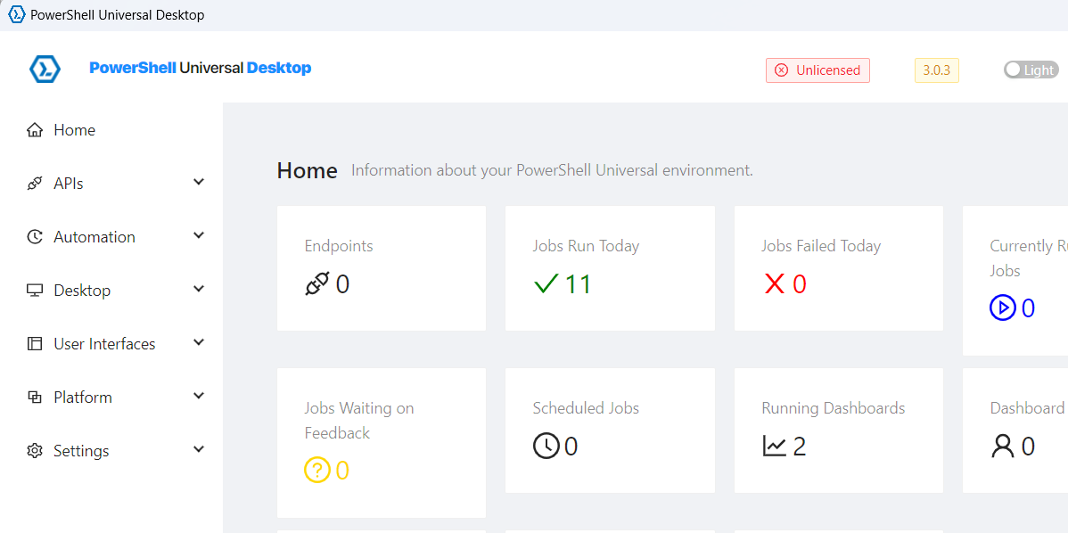
PowerShell Universal Desktop
File Associations
Associate file extensions with PowerShell scripts.
Hotkeys
Associate key board shortcuts with scripts
Protocol Handlers
Associate custom protocols with scripts.
System Events
Associate WMI persistent events with scripts.

Slide 7
Demo

Slide 8
Q&A
https://ironmansoftware.com/psconfeu

